Slide 1
Javascript proxy
Where have you been all my life?
Mike Steensen

Slide 2
JS Proxy Overview
The Proxy object is a special type of object which wraps around another object allowing for the interception of fundamental operations for the target object.
ownKeys()
has()
apply()
Target Object
get()
set()
deleteProperty()
construct()
defineProperty()

Slide 3

Use cases
Object behavior extension
Extend an object’s behavior and provide additional functionality
Access Control
Restricting access to an object’s properties and methods, or disallowing new object properties to be created or modified.
Input Validation/Sanitization
Validate and or sanitize inputs before the object is modified.
Debugging/Logging
Log the access and modification of an object during execution

Slide 4

Call outs
Performance
Proxies are an order of magnitude slower than just using plain old objects.
Limited target types
Proxies only work for objects and functions, primitives are applicable
Internet Explorer?
Internet Explorer (event the latest version) does not support JS Proxies ☹

Slide 5
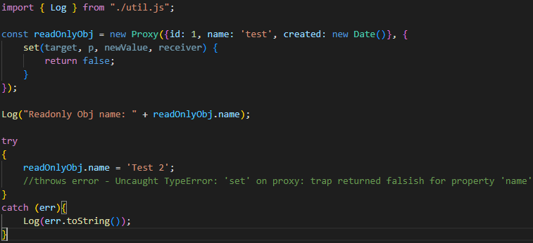
Sample – Read-only Object (Code)

Slide 6
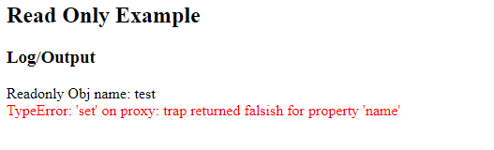
Sample – Read-only Object (Output)

Slide 7
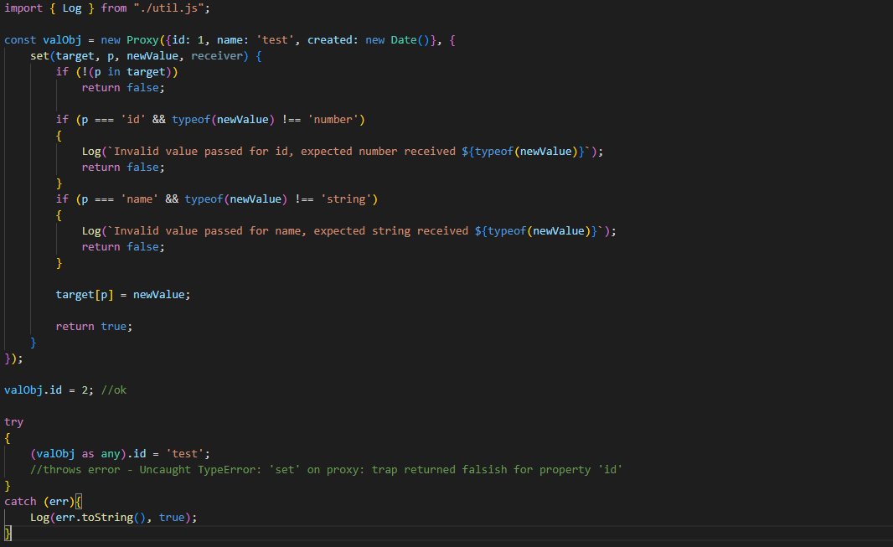
Sample – Input Validation (Code)

Slide 8
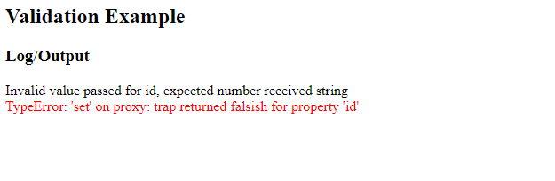
Sample – Input Validation (Output)

Slide 9
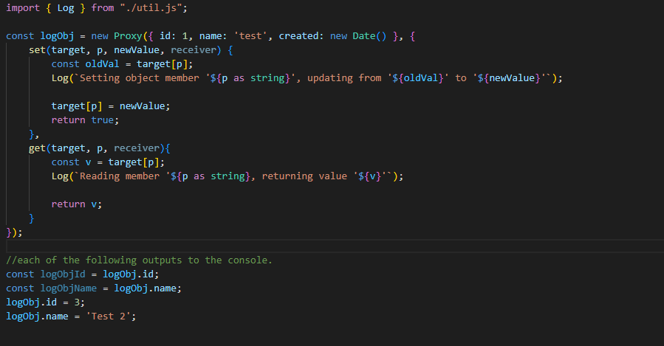
Sample – Debugging (Code)

Slide 10
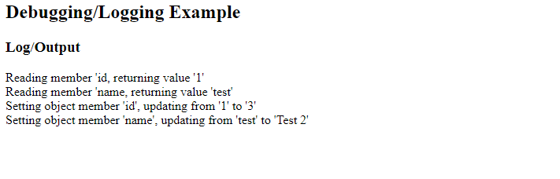
Sample – Debugging (Output)

Slide 11
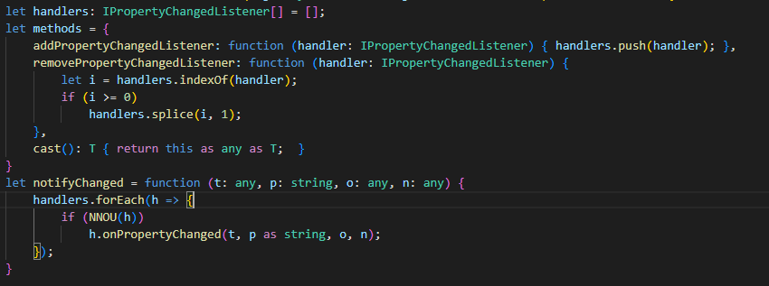
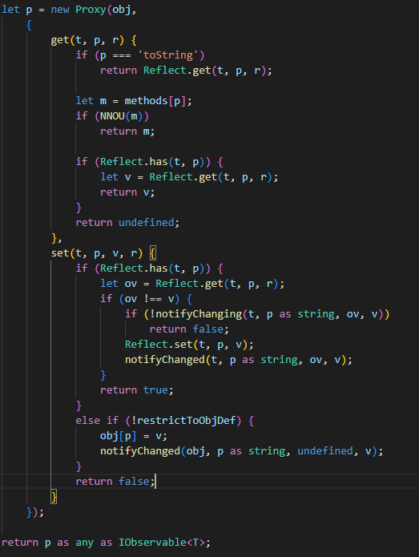
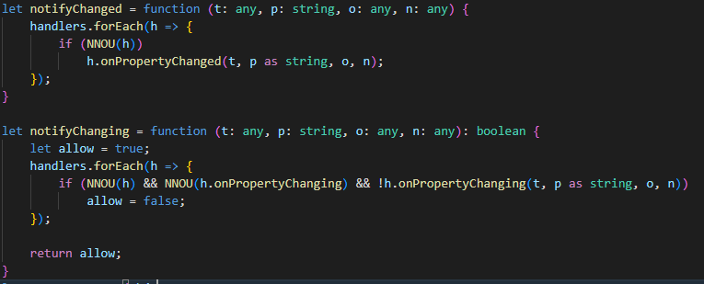
Sample – Observable Object (Code)

Slide 12
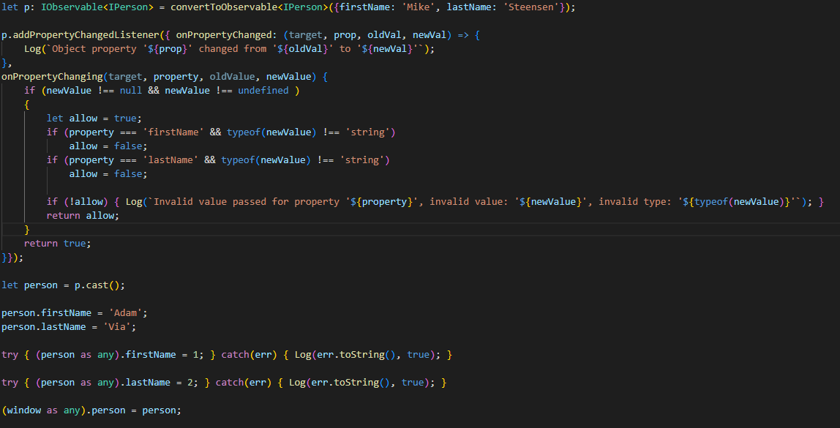
Sample – Observable Object (Code)

Slide 13
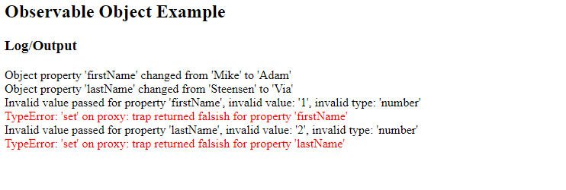
Sample – Debugging (Output)

Slide 14
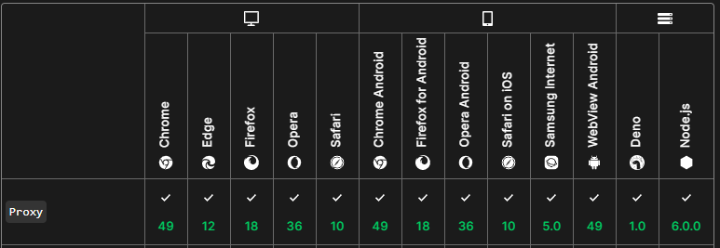
Compatibility/Support
Wide support for the Proxy object exists across the board.
Taken from
https://developer.mozilla.org/en-US/docs/web/javascript/reference/global_objects/proxy

Slide 15

Conclusion
The Proxy Object has many different use cases
Can be used make your code more robust and usable by others.
Can be used to simplify your code where you apply similar concepts now.
Can help with debugging your code or give insight on how external code operates.
You can build simple or very complex scenarios (more examples available in source code)
It’s useful for many situations but not everything
There are tradeoffs with using it (like performance)
For more detailed information regarding the Proxy object visit
https://developer.mozilla.org/en-US/docs/web/javascript/reference/global_objects/proxy
Source Code for presentation: https://github.com/msteensen/js-proxy-lightning-talk
Additional examples available in repository

